Slide 1
British airways review analysis
collecting and analyzing customer reviews from skytrax
November 2022

Slide 2
AGENDA
I. Collecting Data
II. Exploratory Data Analysis
III. Text Analysis

Slide 3
COLLECTING DATA
Review ID | Review Text | Aircraft | Date Flown | Cabin Staff Service | Food & Beverages | Ground Service | Inflight | Entertainment | Seat Comfort | Wifi & Connectivity | Value For Money | Seat Type | Type Of Traveller | Recommended
Scrapping customer reviews about British Airways from the website Skytrax using Beautifulsoup.
Performing data wrangling and save data as a table with columns above to a xlsx file using Pandas.

Slide 4
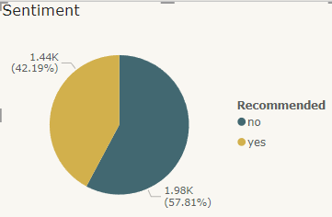
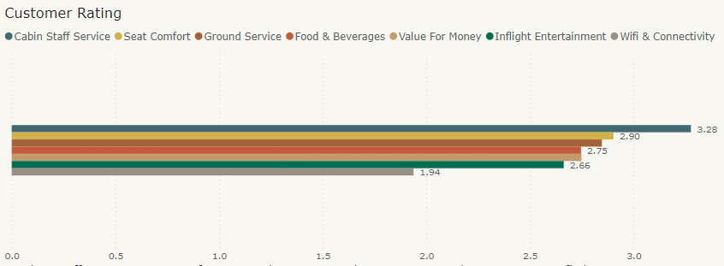
exploratory data analysis
Negative reviews makes up a bigger part than the other group.
Cabin Staff Service has the the highest rate from customers while Wifi & Connectivity has the lowest rating star averagely.

Slide 5
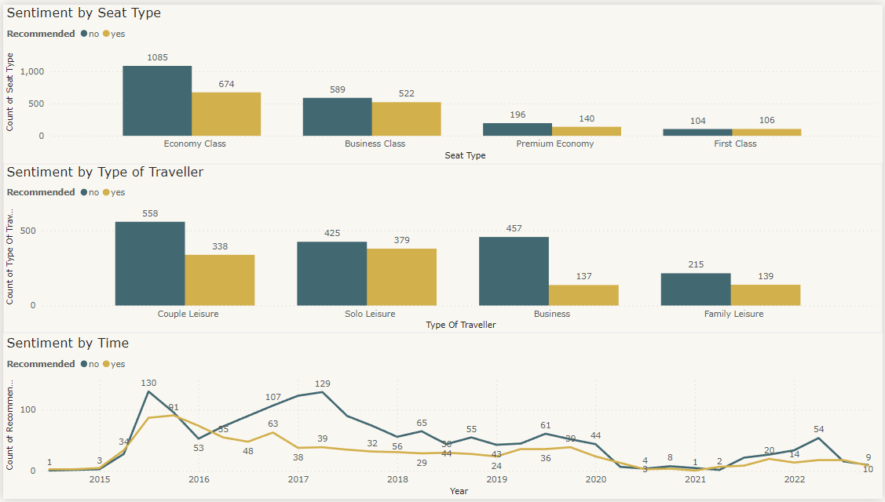
Exploratory data analysis
First Class customers are the most positive group which is the only seat type having the higher number of positive reviews than that of negative one. However, the number of first class reviews is the least significant which is around just 5% of that number of Economy Class.
Customers with business purpose are the most difficult who have the review ratio of 1:3 leading by bad reviews.
Negative reviews significantly overwhelmed postive ones in 2017.

Slide 6
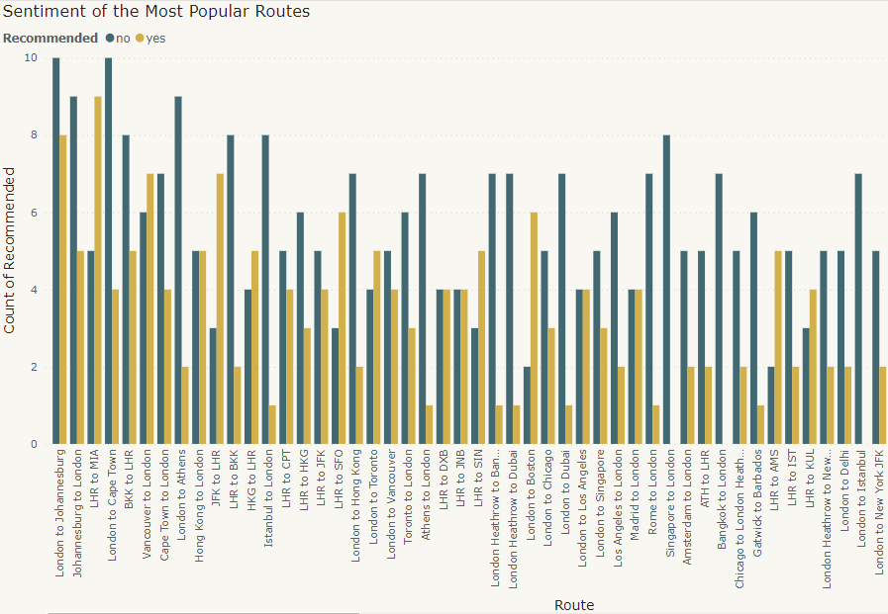
exploratory data analysis
7 out 10 most popular flights have London as either the departure or the destination.
Singapore to London & London to Istabul are 2 popular routes with 100% negative comment.

Slide 7
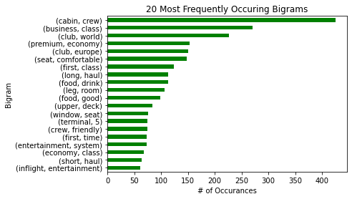
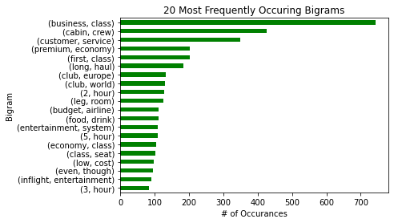
Text analysis
Among all criteria, cabin crew is the most controversial in both groups, which has been referred more than 3 times that amount of the runner-up (food and drink) has been. Another details that attract customers’ attention are seat (monograms), leg room and entertainment system.
The most prominent difference from the content group and the discontent group is the length of the flight they attend. Over-2-hour flights are the frequent words in unhappy customers’ review while 1hr() is the top word of the satisfied group.
Business class is the seat type being referred the most in both groups.
Positive Review
Negative Review
*The 2 words “seat” and “1hr” comes from the monogram analysis

Slide 8
Thank you
November 2022

